Slide 1
3D MEMS MH Final 29th OCT 2022 Au 1v

Slide 2
Component 1

Slide 3
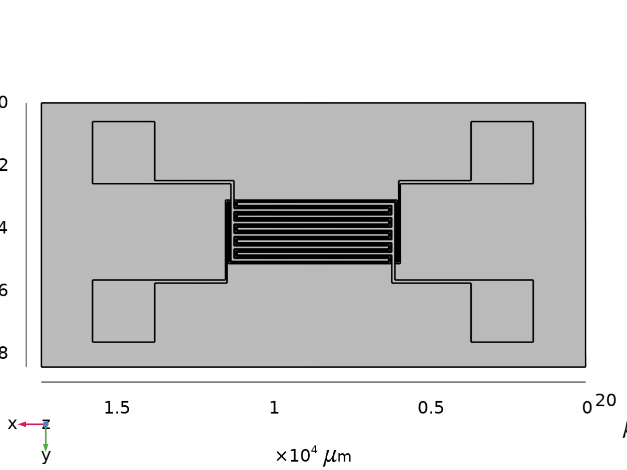
Geometry 1
Units
Length unit | µm
Angular unit | deg
Geometry 1

Slide 4
Geometry 1 (continued)
Geometry statistics
Description | Value
Space dimension | 3
Number of domains | 4
Number of boundaries | 164
Number of edges | 468
Number of vertices | 312
Geometry 1

Slide 5
Materials

Slide 6
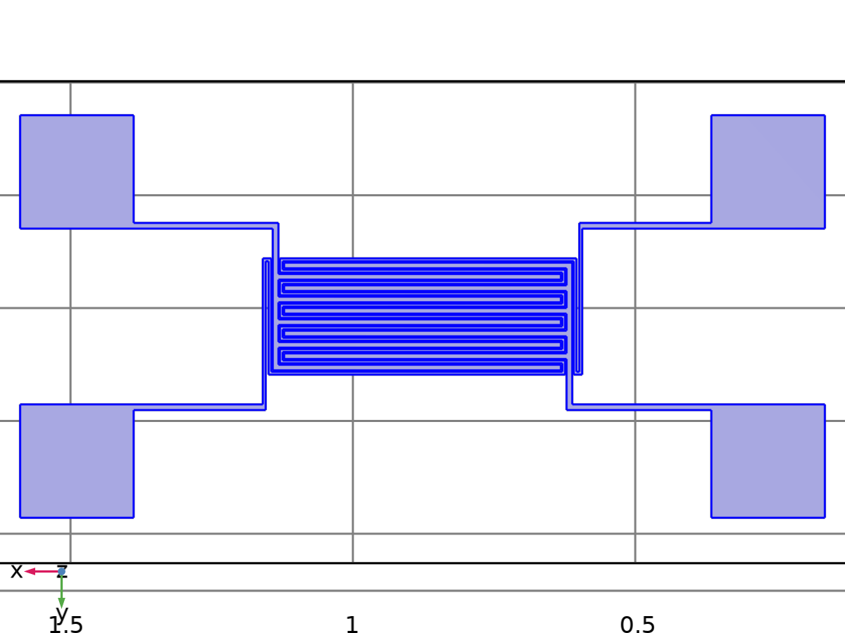
Au - Gold
Selection
Geometric entity level | Domain
Selection | Geometry geom1: Dimension 3: Domains 2–4
Au - Gold

Slide 7
Au - Gold (continued)
Material parameters
Name | Value | Unit
Electrical conductivity | 45.6e6[S/m] | S/m
Coefficient of thermal expansion | 14.2e-6[1/K] | 1/K
Heat capacity at constant pressure | 129[J/(kg*K)] | J/(kg·K)
Au - Gold

Slide 8
Au - Gold (continued)
Material parameters
Name | Value | Unit
Density | 19300[kg/m^3] | kg/m³
Thermal conductivity | 317[W/(m*K)] | W/(m·K)
Relative permittivity | 1 | 1
Young's modulus | 70e9[Pa] | Pa
Poisson's ratio | 0.44 | 1
Au - Gold

Slide 9
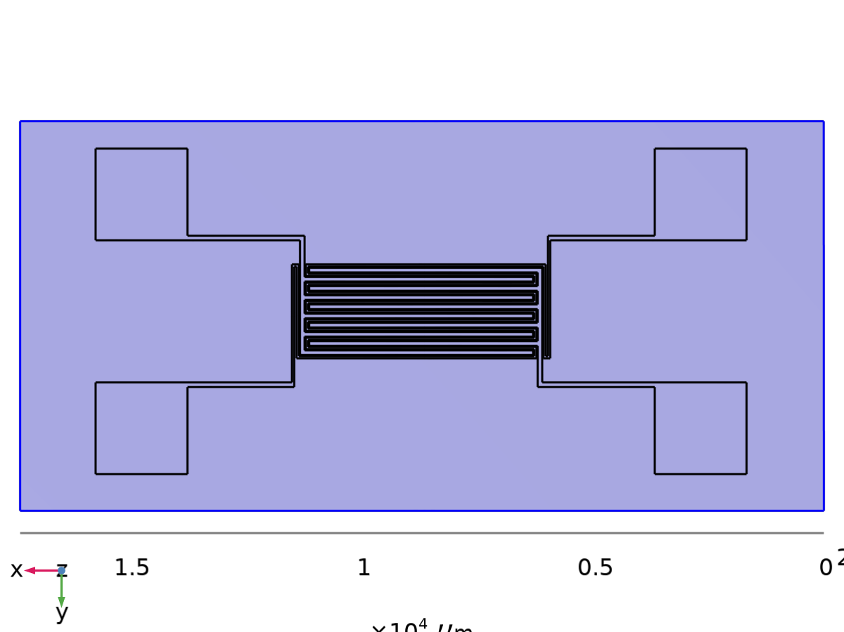
Si - Polycrystalline silicon
Selection
Geometric entity level | Domain
Selection | Geometry geom1: Dimension 3: Domain 1
Si - Polycrystalline silicon

Slide 10
Si - Polycrystalline silicon (continued)
Material parameters
Name | Value | Unit
Coefficient of thermal expansion | 2.6e-6[1/K] | 1/K
Heat capacity at constant pressure | 678[J/(kg*K)] | J/(kg·K)
Relative permittivity | 4.5 | 1
Si - Polycrystalline silicon

Slide 11
Si - Polycrystalline silicon (continued)
Material parameters
Name | Value | Unit
Density | 2320[kg/m^3] | kg/m³
Thermal conductivity | 34[W/(m*K)] | W/(m·K)
Electrical conductivity | 7.69e4[S/m] | S/m
Young's modulus | 160e9[Pa] | Pa
Poisson's ratio | 0.22 | 1
Si - Polycrystalline silicon

Slide 12
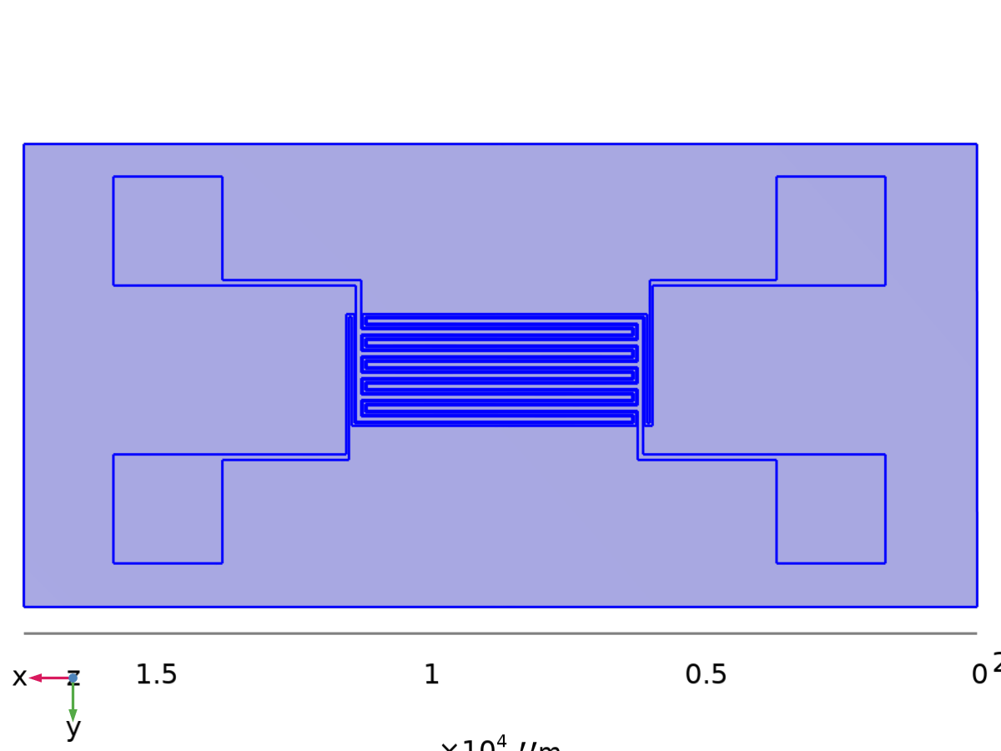
Solid Mechanics
Selection
Geometric entity level | Domain
Selection | Geometry geom1: Dimension 3: All domains
Solid Mechanics

Slide 13

Solid Mechanics (continued)
Equations
Features
Name | Level
Linear Elastic Material 1 | Domain
Free 1 | Boundary
Initial Values 1 | Domain
Solid Mechanics

Slide 14
Solid Mechanics (continued)
Features
Name | Level
Fixed Constraint 1 | Edge
Solid Mechanics

Slide 15
Heat Transfer in Solids
Selection
Geometric entity level | Domain
Selection | Geometry geom1: Dimension 3: All domains
Heat Transfer in Solids

Slide 16

Heat Transfer in Solids (continued)
Equations
Features
Name | Level
Solid 1 | Domain
Initial Values 1 | Domain
Heat Transfer in Solids

Slide 17
Heat Transfer in Solids (continued)
Features
Name | Level
Thermal Insulation 1 | Boundary
Temperature 1 | Boundary
Heat Transfer in Solids

Slide 18
Electric Currents
Selection
Geometric entity level | Domain
Selection | Geometry geom1: Dimension 3: All domains
Electric Currents

Slide 19



Electric Currents (continued)
Equations
Electric Currents

Slide 20
Electric Currents (continued)
Features
Name | Level
Current Conservation 1 | Domain
Electric Insulation 1 | Boundary
Initial Values 1 | Domain
Ground 1 | Edge
Electric Potential 1 | Edge
Electric Currents

Slide 21
Multiphysics

Slide 22
Thermal Expansion 1
Selection
Geometric entity level | Domain
Selection | Geometry geom1: Dimension 3: All domains
Thermal Expansion 1

Slide 23

Thermal Expansion 1 (continued)
Equations
Thermal Expansion 1

Slide 24
Electromagnetic Heating 1
Electromagnetic Heating 1

Slide 25
Electromagnetic Heating 1 (continued)
Selection
Geometric entity level | Domain
Selection | Geometry geom1: Dimension 3: All domains
Boundary selection

Slide 26


Electromagnetic Heating 1 (continued)
Equations
Boundary selection

Slide 27
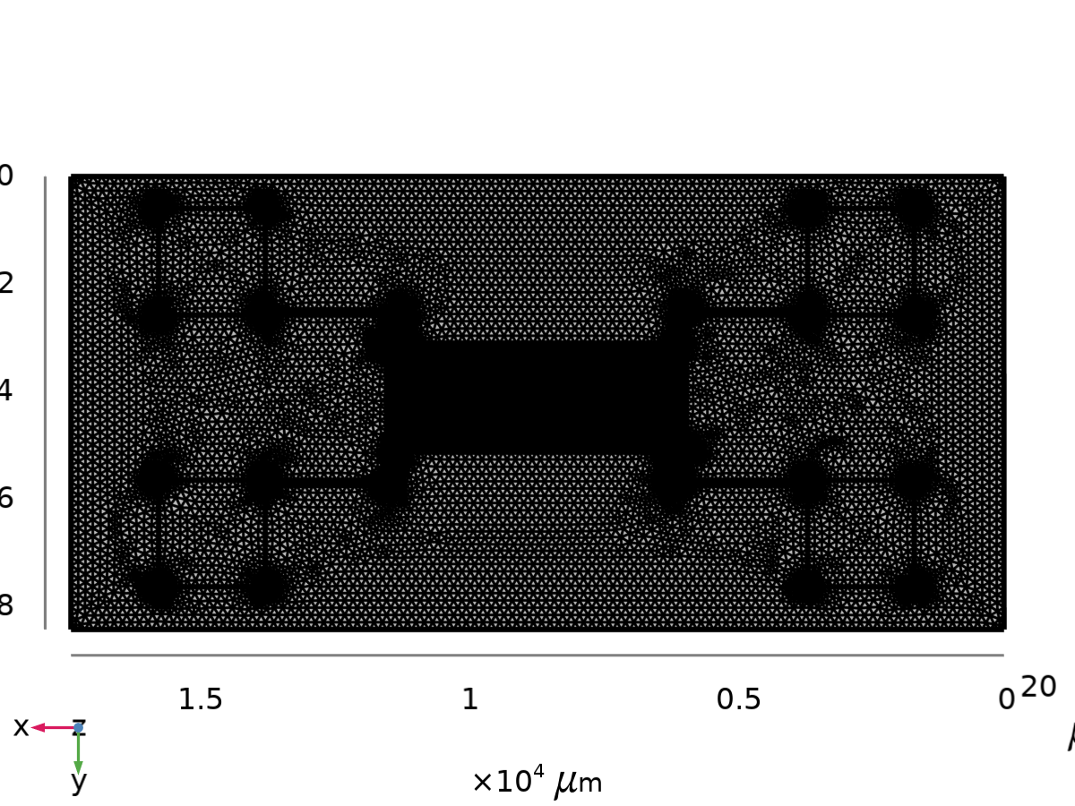
Mesh 1
Mesh statistics
Description | Value
Status | Complete mesh
Mesh vertices | 56368
Tetrahedra | 200522
Triangles | 109029
Edge elements | 11194
Vertex elements | 312
Number of elements | 200522
Mesh 1

Slide 28
Mesh 1 (continued)
Mesh statistics
Description | Value
Minimum element quality | 4.51E-5
Average element quality | 0.3162
Element volume ratio | 7.3963E-10
Mesh volume | 7.441E9 µm³
Mesh 1

Slide 29
Results

Slide 30
Datasets

Slide 31
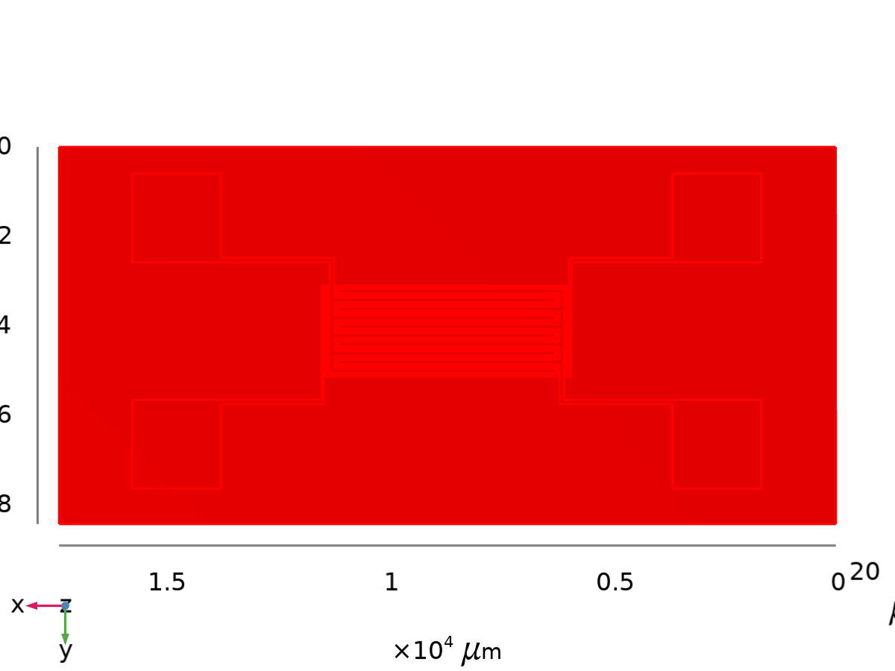
Study 1/Solution 1
Solution
Description | Value
Solution | Solution 1
Component | Component 1 (comp1)
Dataset: Study 1/Solution 1

Slide 32
Tables

Slide 33
Evaluation 3D
Interactive 3D values
x | y | z | Value
8585.7 | 4018.5 | 50.100 | 2471.8
8316.9 | 3964.8 | 50.100 | 2468.4
8827.7 | 4341.2 | 50.100 | 2470.6
8935.2 | 3857.2 | 50.100 | 2470.8
9096.5 | 3937.9 | 50.100 | 2468.8

Slide 34
Evaluation 3D (continued)
x | y | z | Value
8854.6 | 3911.0 | 50.000 | 2471.5
9096.5 | 3884.1 | 50.100 | 2468.9
8908.3 | 4018.5 | 50.100 | 2471.1
9082.8 | 3982.1 | 50.000 | 327.15
9137.3 | 4127.1 | 50.100 | 598.89
8762.7 | 4059.0 | 50.100 | 837.85

Slide 35
Plot Groups

Slide 36
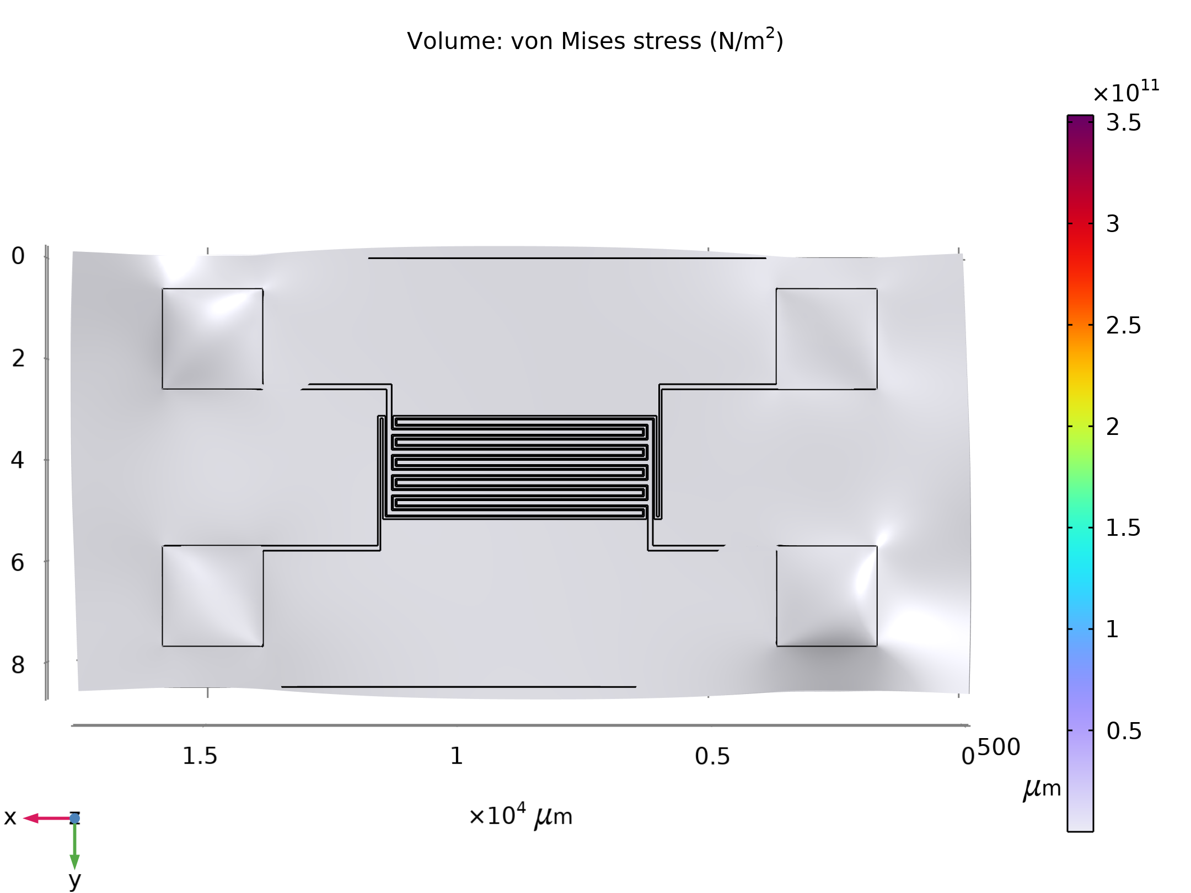
Stress (solid)
Volume: von Mises stress (N/m²)

Slide 37
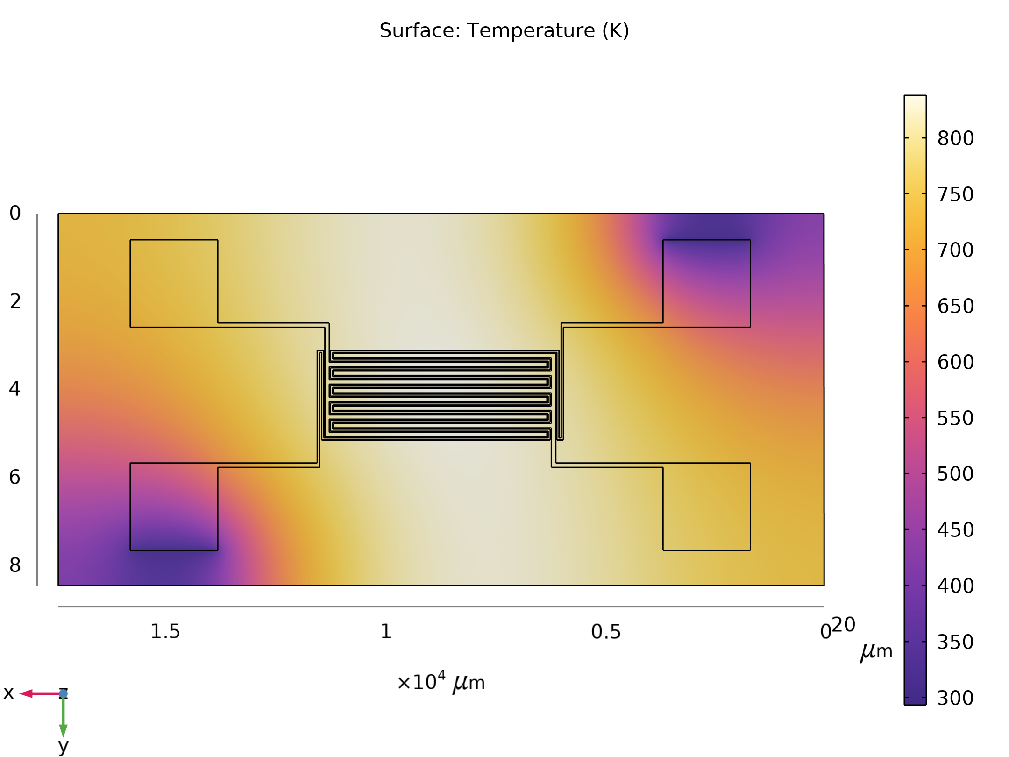
Temperature (ht)
Surface: Temperature (K)

Slide 38
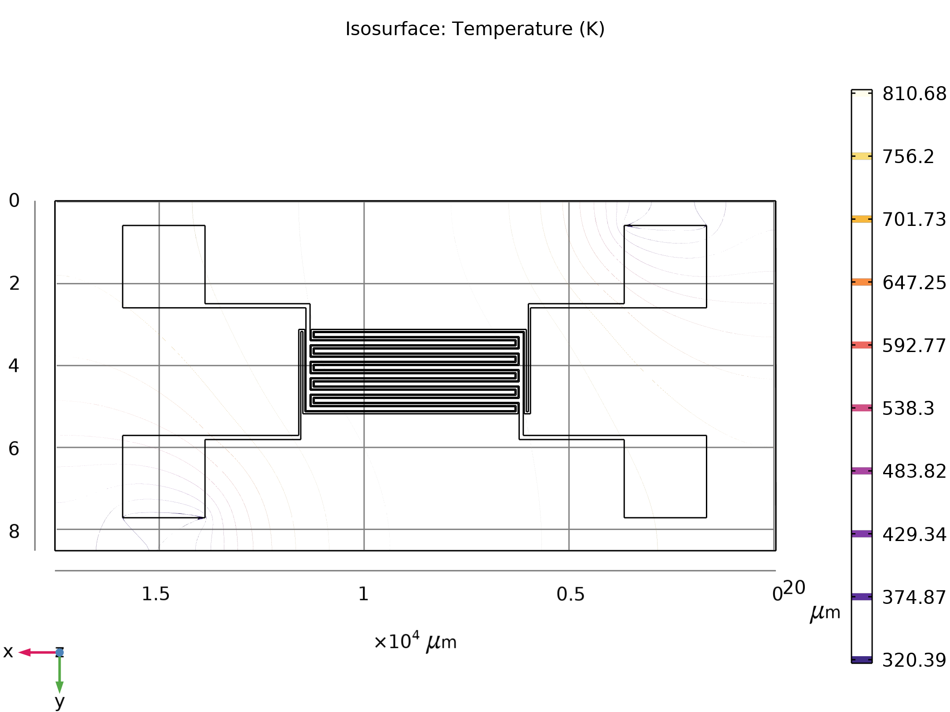
Isothermal Contours (ht)
Isosurface: Temperature (K)

Slide 39
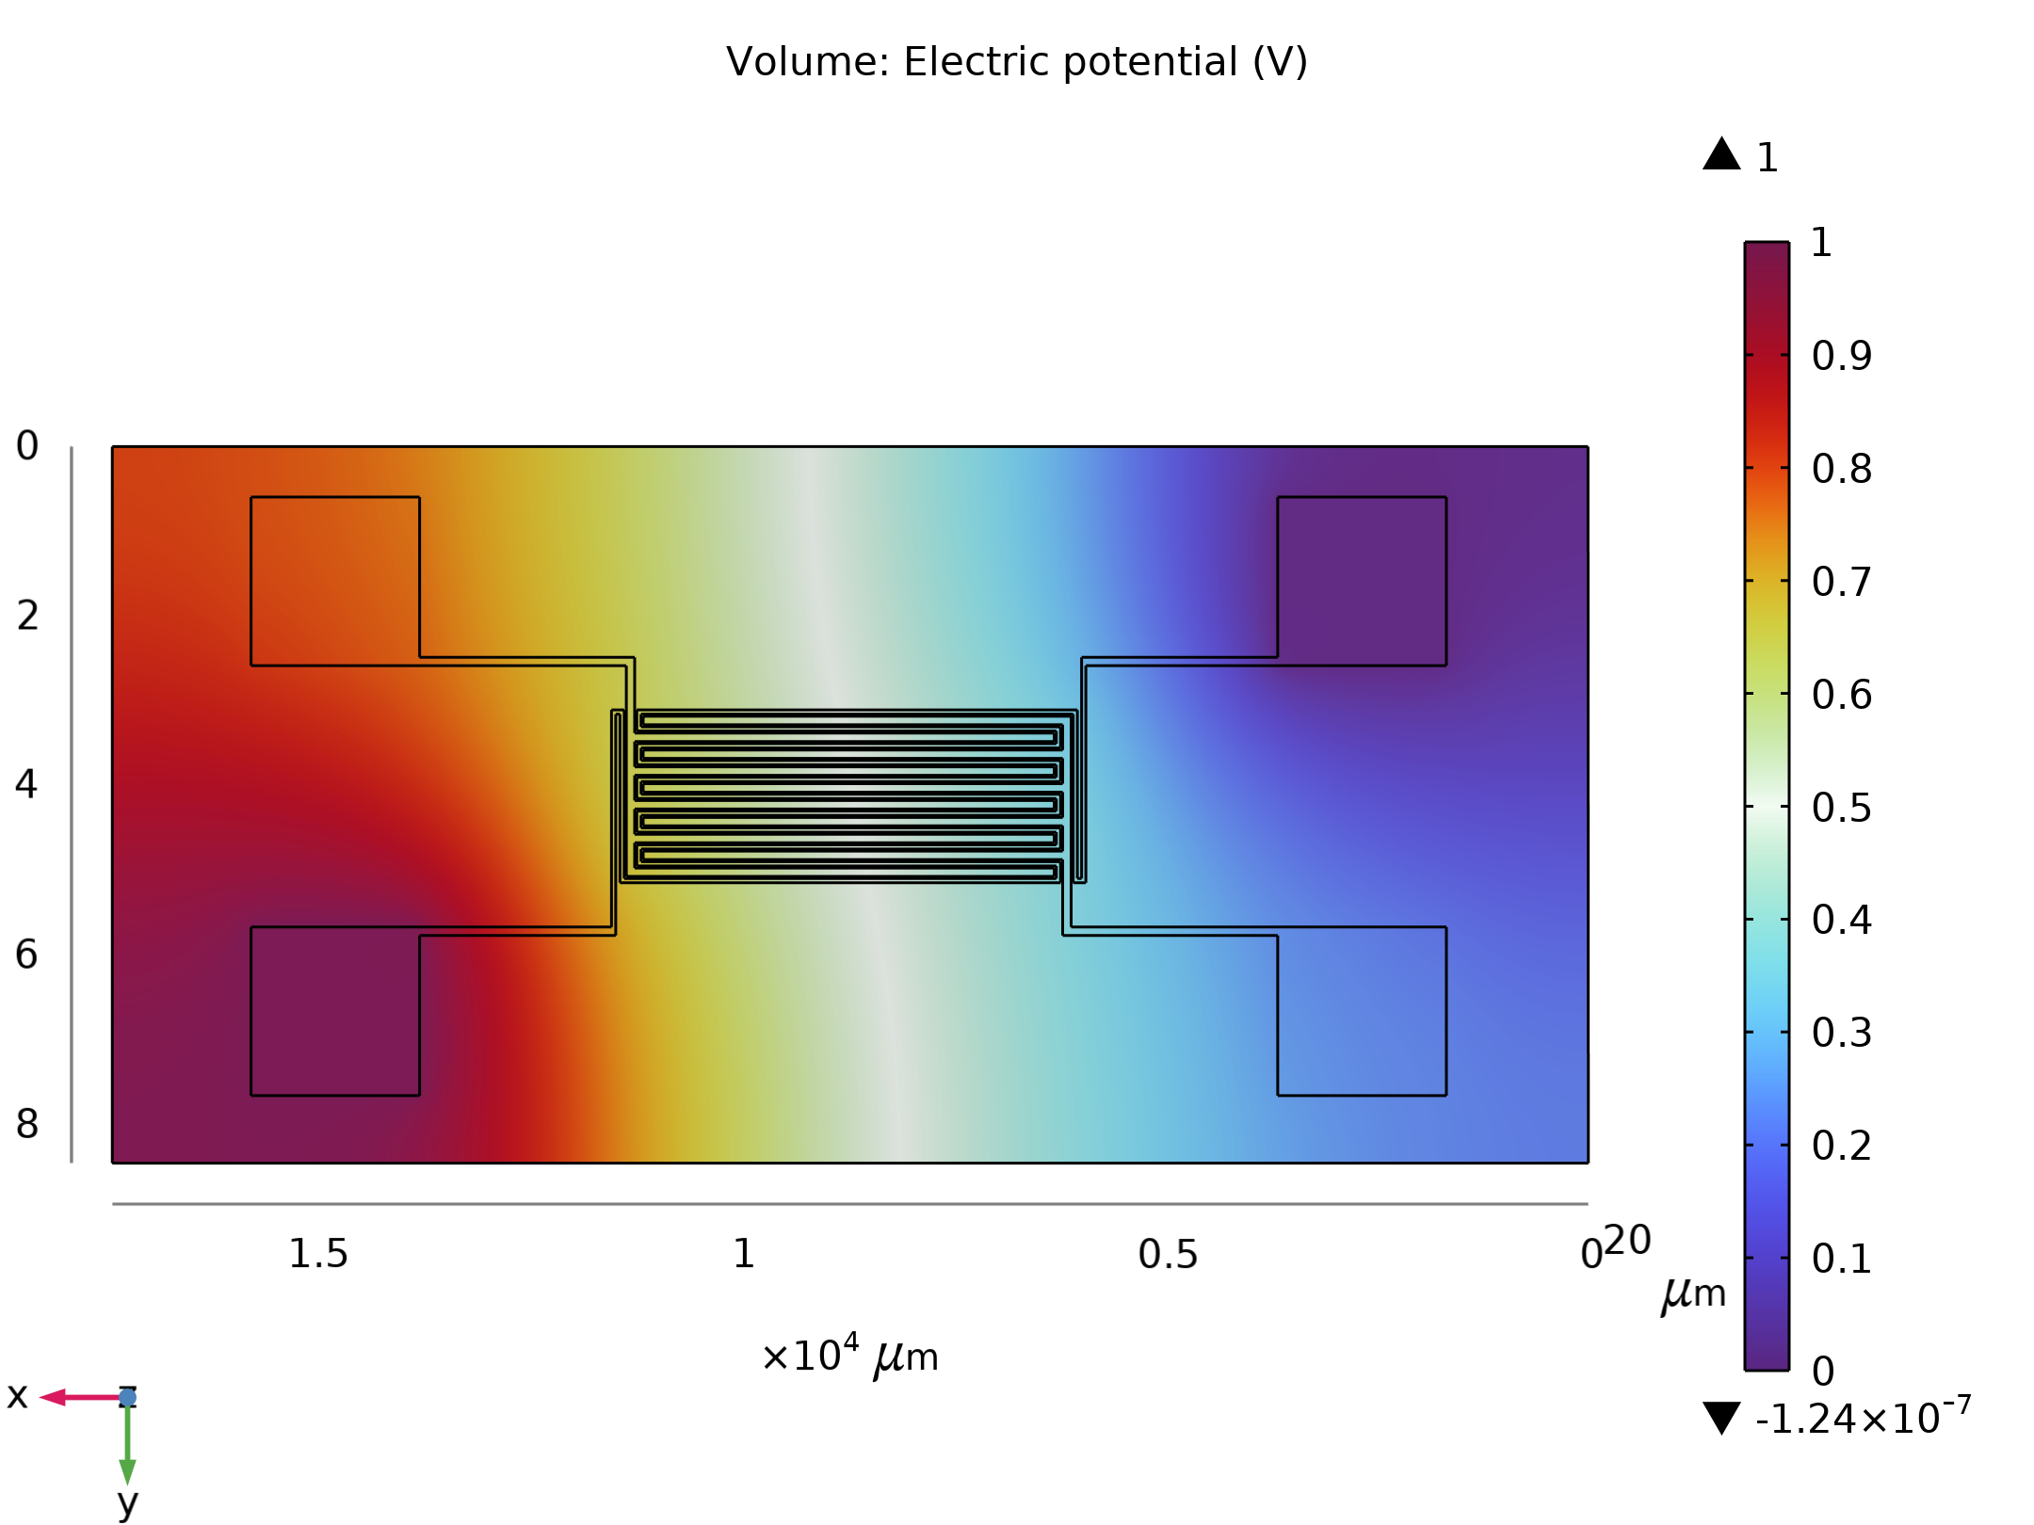
Electric Potential (ec)
Volume: Electric potential (V)

Slide 40
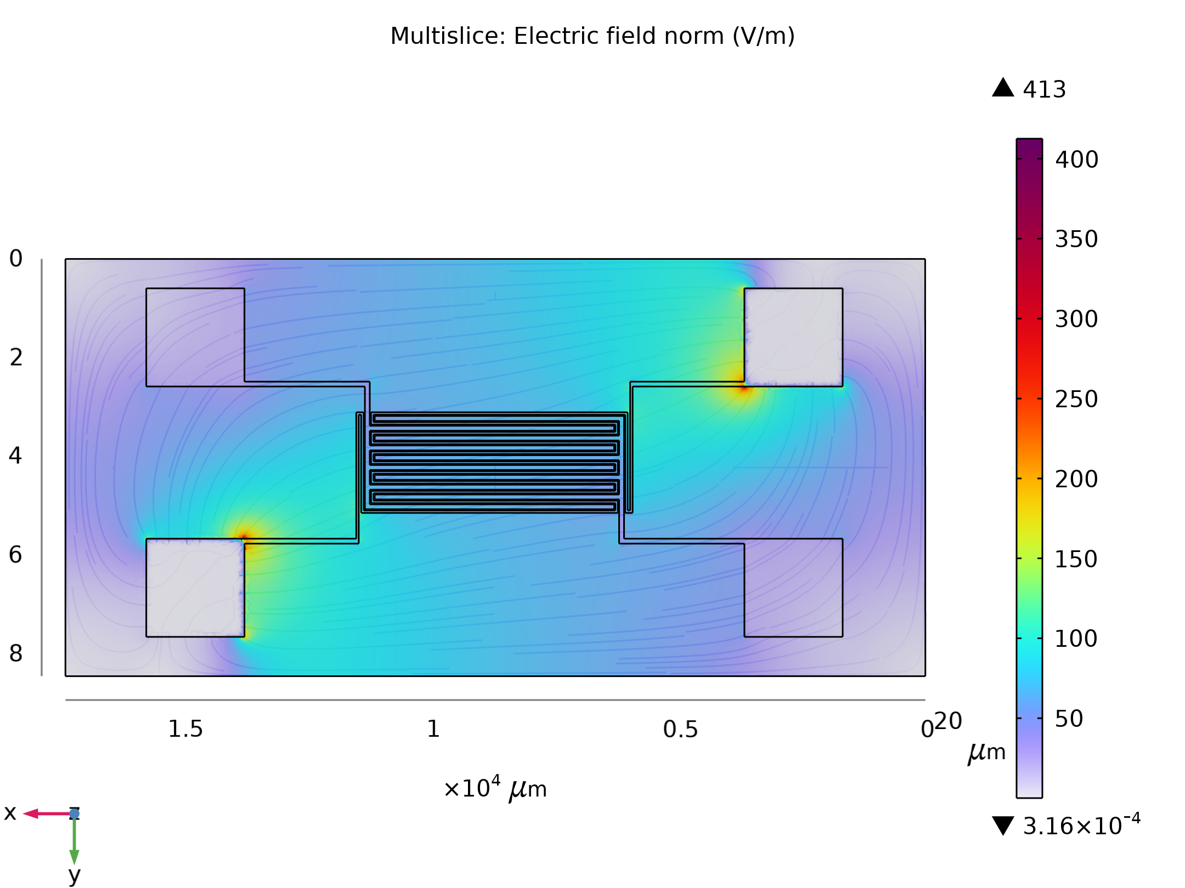
Electric Field Norm (ec)
Multislice: Electric field norm (V/m)

